Slide 1
Food Sales Predictions
Dany Trainor

Slide 2
Data and Goals
Source: Analytics Vidhya Hackathon: Big Mart Problem
Features examined: Item weight, fat content, visibility, type, MRP, outlet establishment year, outlet size, outlet location type, outlet type
Goal: to create a machine learning model that can predict the sales of various food items based on the above features

Slide 3
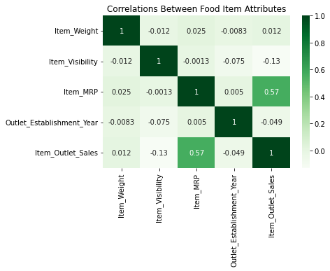

Slide 4
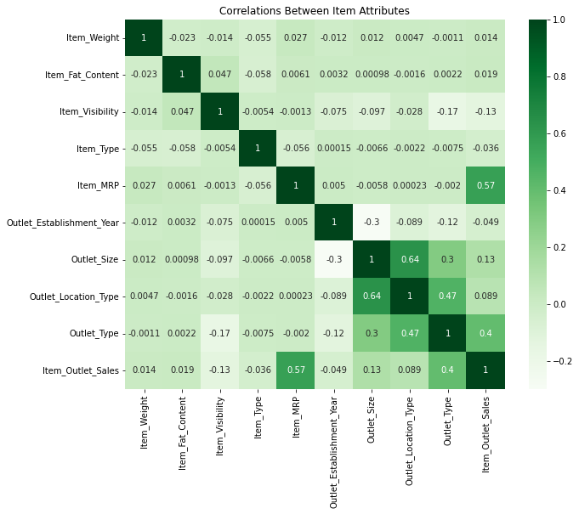

Slide 5
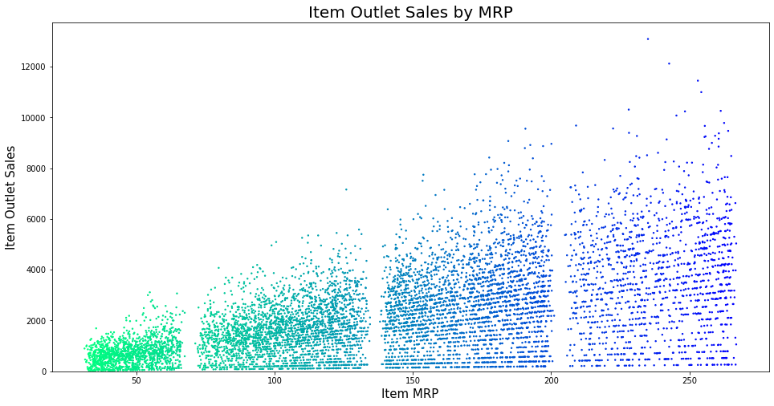

Slide 7
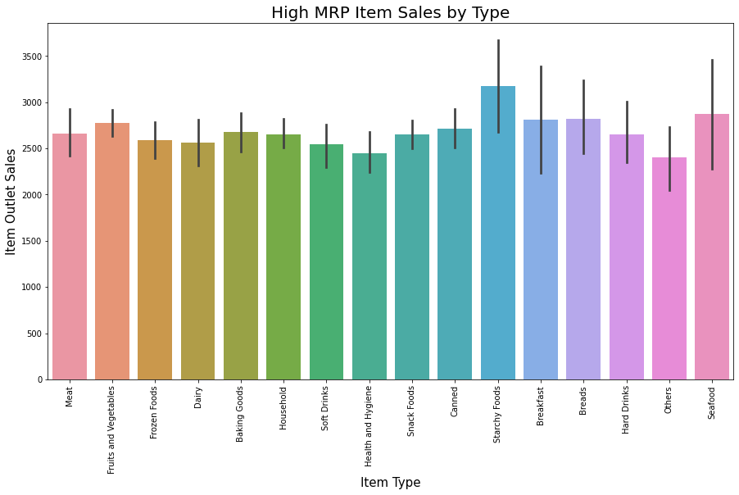

Slide 8
Recommendations
Decision tree model
Lower error compared to other models on multiple metrics
Can predict high and low sales based on multiple variables
MRP can further guide stocking choices based on production costs
Stocking high MRP items in larger location types (Supermarket Type 3) may further sales of target products

